Slide 1
Logic Gates for PowerPoints
https://www.tes.com/en-us/teaching-resource/logic-gate-symbols-for-powerpoint-11139006

Slide 2
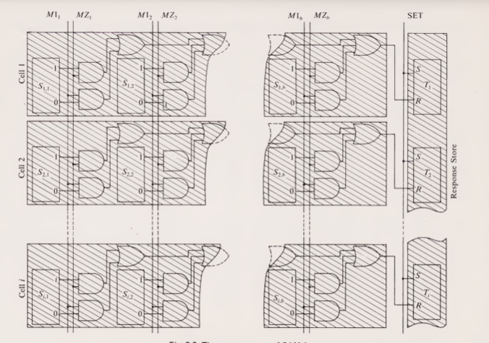

Slide 3
M1₁
MZ₁
M1₂
MZ₂
M1_{b}
MZ_{b}
SET
S_{1,1}
S_{1,2}
S_{1,b}
T₁
Cell 1
1
1
1
S
0
0
0
R
S_{2,1}
S_{2,2}
S_{2,b}
T₂
Cell 2
1
1
1
S
0
0
0
R
S_{n,1}
S_{n,2}
S_{n,b}
T_{n}
Cell n
1
1
1
S
0
0
0
R

Slide 4
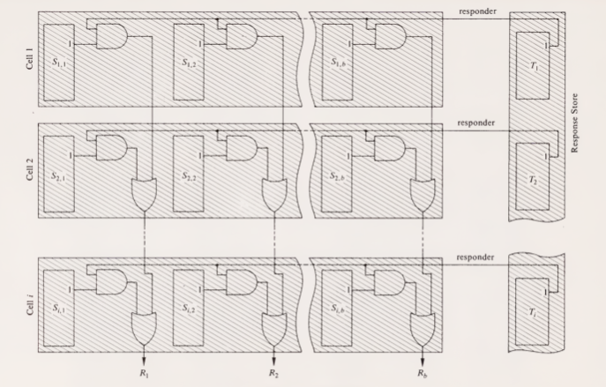

Slide 5
S_{1,1}
S_{1,2}
S_{1,b}
T₁
Cell 1
1
1
1
1
S_{2,1}
S_{2,2}
S_{2,b}
T₂
Cell 2
1
1
1
1
S_{n,1}
S_{n,2}
S_{n,b}
T_{n}
Cell n
1
1
1
1
R₁
R₂
R_{b}

Slide 6
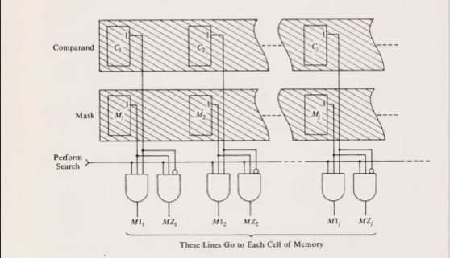

Slide 7
C₁
C₂
C_{b}
Comparand
1
1
1
M₁
M₂
M_{b}
Mask
1
1
1
Perform
Search
M1₁
MZ₁
M1₂
MZ₂
M1_{b}
MZ_{b}

Slide 8
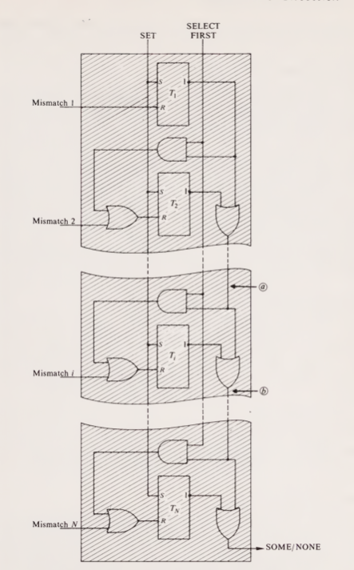

Slide 9
SELECT
FIRST
SET
T₁
S
1
Mismatch 1
R
T₂
S
1
Mismatch 2
R
T_{n}
S
1
Mismatch n
R
SOME/NONE

